Slide 1

DONATE THE BLOOD
Devloped By: Vishal Kumar

Slide 2

Team Leader: Vishal Kumar
Team Member: Vishal Kumar,Yashwant Singh
Project Supervisor: Dr. Sangeeta Arora(Associate Professor)

Slide 3

INTRODUCTION
The Blood Donation Management System is a pivotal initiative aimed at revolutionizing the way blood donation and recipient matching is facilitated. With the primary goal of bridging the gap between blood donors and those in critical need, this web-based application provides a cohesive platform for individuals and healthcare providers to efficiently manage and access vital blood resources.
In many situations, timely access to compatible blood can be a matter of life and death. The conventional methods of blood donation coordination often fall short in providing immediate and precise solutions. This project seeks to address this challenge by leveraging modern web technologies to create a robust, user-friendly, and secure platform.
By allowing both donors and recipients to register and maintain comprehensive profiles, the system establishes a dynamic database of potential blood donors and recipients. Donors can conveniently record their contributions, while recipients can specify their unique blood requirements, thereby creating a seamless channel for matching.

Slide 4
The system's intelligent search and filter functionalities enable recipients to pinpoint suitable donors based on specific criteria, including blood type, location, and availability. This precision ensures that recipients receive the most compatible blood, optimizing the chances of successful transfusions
Furthermore, the system incorporates a secure authentication mechanism to safeguard user data and privacy. With measures in place to validate and sanitize user input, the application prioritizes the security of its users. An administrative panel provides oversight, allowing for the management of user accounts and monitoring of donation records.
The Blood Donation Management System is not merely a technological solution; it is a lifeline for individuals in dire need of blood transfusions. By fostering a sense of community and responsibility, this project aspires to save lives, one donation at a time. Through the power of technology, it endeavors to create a reliable and accessible blood supply network that can make a profound impact on healthcare outcomes.

Slide 5

Hardware requirement / Technologies
Hardware Environment
Operating system : windows
Intel i3 1.5GHz or above.
4GB ram.
80GB HDD Minimum.
System Design and Architecture:
Database schema design
Technology selection (e.g., PHP, HTML/CSS/JS, MySQL)
Implementation (Coding):
Backend logic development in PHP
Frontend development (HTML/CSS/JS)

Slide 6

Software Requirements
Operating system
Windows XP/7/10.
Language
HTML,CSS ,JAVASCRIPT and PHP
IDE
visual studio code
Database
MYSQL (Install XAMPP)

Slide 7

Modules Description
Admin Module:
Dashboard: In this section, admin can view all the details in brief like total blood group listed, registered donor list, and total enquiries received.
Blood Group: In this section, admin can manage blood group(Add/ Delete).
Donor List: In this section, admin can view a list of donors and have the right to delete and hide the detail of donor.
User Module:
Home: Its is welcome page for users and donor. If any users want to donate the blood they must register with us.
About Us: Users can view the about us page.
Contact Us: Users can contact with admin the through contact us page.
Donor List: Users can view and contact donors.
Search Donor: Users can search the donor according to city and blood group.

Slide 8

Registered Users(Donor):
Home: It is a welcome page for users and donors. If any users want to donate their blood they must register with us.
About Us: Users can view the about us page.
Contact Us: Users can contact with admin the through contact us page.
Donor List: Users can view and contact with donor.
Search Donor: Users can search the donor according to city and blood group.
My Account:
Profile
Change Password
Request Received
Logout
Donor can also update their profile, change their password and recover their password.

Slide 9
Reports / Outputs
The outputs of a blood donation project refer to the tangible results, products, or deliverables that are generated as a result of the project's activities and efforts. These outputs can vary depending on the specific goals and objectives of the project, but here are some common outputs you might expect from a blood donation project:
Donor Recruitment and Registration:
Number of new blood donors recruited.
Details of registered donors, including contact information.
Blood Collection and Processing:
Documentation of blood collection procedures.
Information on how the collected blood is processed, tested, and stored.
Data and Reports:
Data collected on donor demographics.
Reports summarizing project activities, outcomes, and impact.
These outputs should be documented and organized to evaluate the project's success, demonstrate accountability to stakeholders, and facilitate future planning and reporting. Additionally, they can serve as a valuable resource for promoting and expanding blood donation efforts in the future.

Slide 10
Conclusion
A majority of the donors were willing to be regular donors. The donors showed positive effects like a sense of satisfaction after the donation. Creating an opportunity for blood donation by conducting many blood donation camps may increase the voluntary blood donations.
Most of the donors in the study group opined that the motivating factors for the recruitment of more donors were, creation of opportunities to donate and the need to be well-informed about the need of blood. A majority of the donors were willing to be regular donors. The donors showed positive effects like a sense of satisfaction after the donation. In our study, most of the donors were knowledgeable about the blood donation and they had a good attitude towards it; however, they felt comfortable in donating blood once a year. If this feel good factor of a once a year donation could be changed into atleast twice a year, the gap between the demand and the supply of the country could be narrowed down. Creating opportunities for blood donations by conducting many blood donation camps may provide a solution for our blood demand.
Keywords: Blood donation, Knowledge, Motivation, Voluntary donors

Slide 11
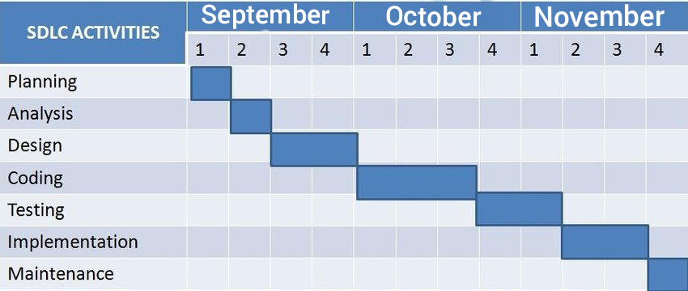
Gantt Chart

Slide 12


